Slide 1
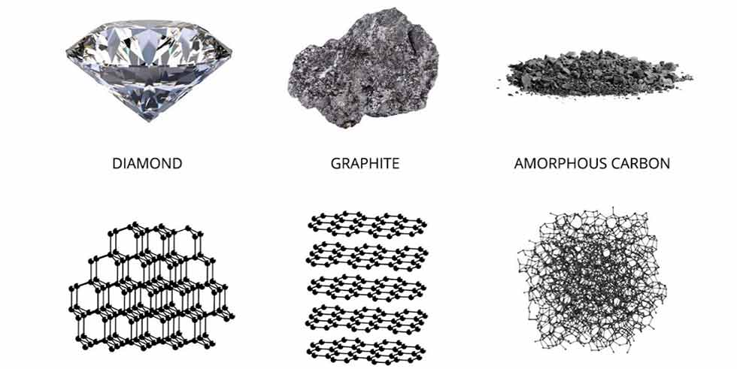
CRYSTALLINE SUBSTANCE
AMORPHOUS SUBSTANCE

Slide 2

DIAMOND
Diamond is the hardest known naturally occurring substance

Slide 3
DIAMOND

Slide 4
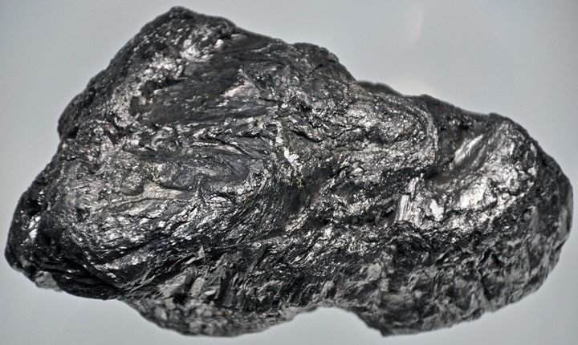
GRAPHITE
Graphite occurs naturally as plumbago, an opaque black solid

Slide 5
GRAPHITE

Slide 6
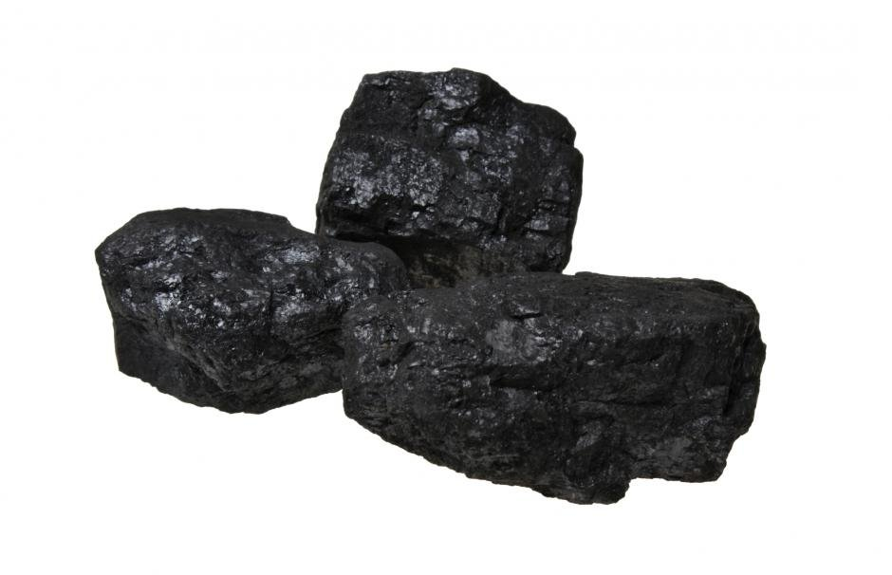
COAL
Coal is an organic sedimentary rock that forms from the accumulation of plant debris, usually in a swamp environment

Slide 7
COAL

Slide 8
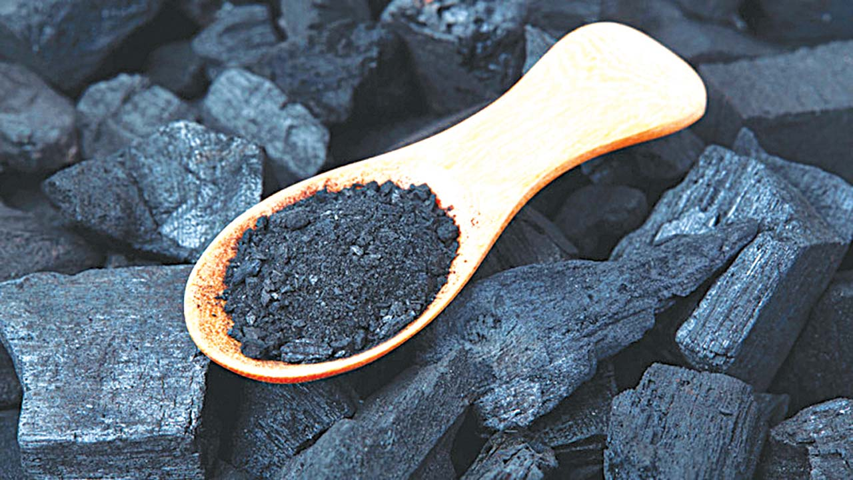
CHARCOAL
This is made by heating wood in a limited supply of air

Slide 9
CHARCOAL

Slide 10
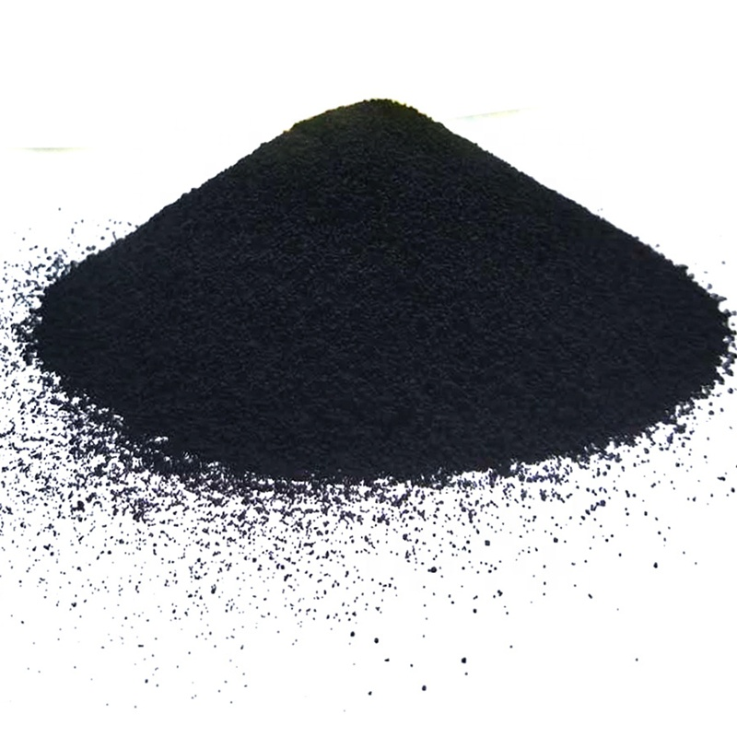
CARBON BLACK
Carbon black is a finely divided carbon particles produced by burning carbonaceous material in a limited supply of air. Lamp black is obtained from lamp oils

Slide 11
CARBON BLACK

Slide 12
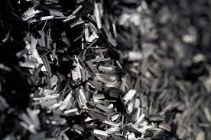
CARBON FIBRES
They are produced carefully heating fibres of materials such as poly propenontrile until they char to form carbon

Slide 13
CARBON FIBRE

